Slide 1

Army Performance Triad
)

Slide 2
Learning Objectives
Summarize the purpose and focus of the Army’s Performance Triad
Identify the three tenets of the Army’s Performance Triad and the key message of each tenet
Identify the Performance Triad Targets and areas for individual improvement

Slide 3
Purpose and Focus of Army Performance Triad
Purpose: The Army Performance Triad serves as a comprehensive plan to improve readiness and increase resilience through public health initiatives and leadership engagement
Focus: The focus of Performance Triad is on Sleep, Activity, and Nutrition
Key actions that influence health in the “Lifespace” to mitigate possible injuries and improve professional readiness
The biggest impact on health is making better choices in your “Lifespace” without a medical provider

Slide 4
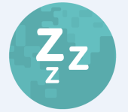
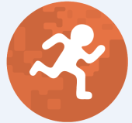

Three Tenets/Messages of the Army’s Performance Triad
Sleep is vital for health, performance, and well-being, with healthy sleep, Soldiers are able to excel mentally and physically and sleep is critical for sustaining the brains capabilities needed for success on and off the battlefield
Exercise and movement help maintain key mental abilities-memory, reaction time, attention span, and learning, these are essential to perform your best and to accomplish any mission
Proper nutrition is about getting the right nutrients at the right time to improve overall fitness and training results, proper nutrition helps you perform at your best and prepares you for your next mission

Slide 5
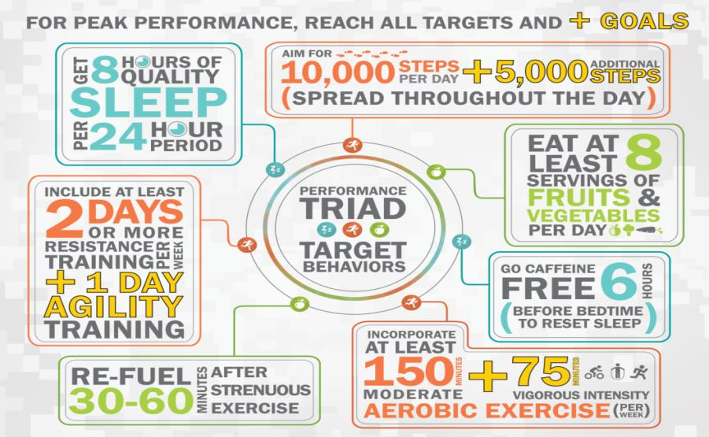
Performance Triad Targets for Adults

Slide 6

Performance Triad Targets for Students

Slide 7
Areas for Improvement
Azimuth Check! What are your targets for improvement?
1) How much sleep do I get a night? ___ hours
2) How many steps do I get a day? _______ steps (1 mile = 2,000 steps)
3) How many servings of fruits and vegetables do I get in a day? __ servings
4) Do I typically eat or drink something with caffeine in it within 6 hours of bedtime? ____ (Yes/No)
5) How many days of resistance (strength) training do I include each week? (____ days) Do I include agility training? _______ (yes/no)
6) How many minutes of moderate intensity exercise ( ____ min) and vigor­ous intensity exercise ( ____ min) do I perform in a week?
7) After strenuous exercise, when do I re-fuel? ___ minutes after exercise
MY TARGET FOR IMPROVEMENTS: #_______

Slide 8
Practical Exercise
Implementation of the Performance Triad
Performance Triad Plan:
The Tenets of the Army’s Performance Triad are meant to increase overall total health and fitness to maintain optimum performance
Instructions:
Divide into two groups and select a group leader
Discuss your group’s scenario from the Student Handout for five minutes and list your plan of action in the chart on the handout
Be prepared to provide your group’s summary to the class for discussion

Slide 9
Assessment
End of Class Lesson Assessment
Instructions:
Individually provide answers to the end of class assessment
You have five minutes for completion
Turn in assessment to instructor upon completion

Slide 10
Closing
Review Learning Objectives:
Summarize the purpose and focus of the Army’s Performance Triad
Identify the three tenets of the Army’s Performance Triad and the key message of each tenet
Identify the Performance Triad Targets and areas for individual improvement
Questions
Next Lesson:
CADET POST-CLASS ASSIGNMENT
Complete writing program assignment (three – five page essay); turn in to cadre at next class

